Slide 1
Finding the Surface Area
Slideshow by
Mr. Braverman
Trenton Public Schools
May 2015

Slide 2
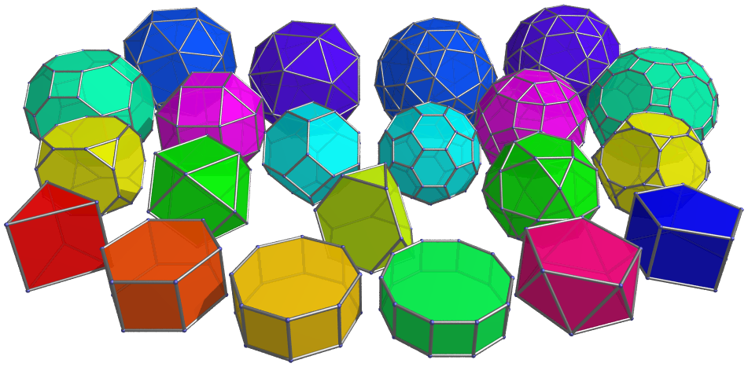
What is Surface Area
Surface Area refers to
geometric shapes
that are three dimensional
Such as
and other polyhedra
prisms
pyramids
cubes

Slide 3
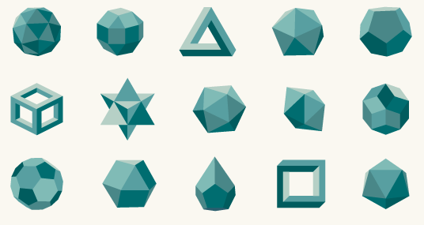
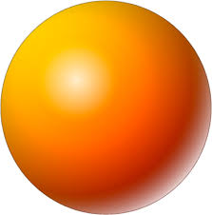
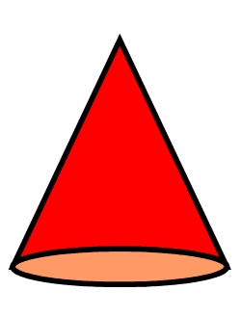
What is Surface Area
as well as:
etc.
spheres
cylinders
cones

Slide 4
Refresher: What is AREA?
Area is the number of unit squares it takes to completely cover an object without any gaps or overlaps.
5 units
1 unit
1 unit
1 unit
1 unit
1 unit
Unit Square
Unit Square
Unit Square
Unit Square
Unit Square
1 unit
1 unit
1 unit
1 unit
1 unit
1 unit
1 unit
1 unit
1 unit
1 unit
2 units
So a rectangle 2 units high and 5 units across would have an area of 10 square units.
We can write this as:
Area = base x height
A = bh
A = 5u x 2u
A = 10u²
Unit Square
Unit Square
Unit Square
Unit Square
Unit Square
1 unit
1 unit
1 unit
1 unit
1 unit

Slide 5
What is Surface Area
There are two basic kinds of surface area.
The least common kind is called
Lateral Surface Area
which only includes the “walls” and
not the “floors and ceilings”
of geometric shapes…

Slide 6
What is Surface Area
There are two basic kinds of surface area.
Lateral Surface Area
which only includes the “walls” and
not the “floors and ceilings”
of geometric shapes…
(We won’t see too much of this.)

Slide 7
What is Surface Area
There are two basic kinds of surface area.
The most common is also called
Total Surface Area.
Total Surface Area
has a very easy definition:
The total of the areas
of all the surfaces.

Slide 8
How do I find the surface area of an object?
There are 3 steps to finding the surface area:
Identify all surfaces
Find the area of each surface individually
Add them up.

Slide 9
How do I find the surface area of an object?
face area
Basic Vocabulary:
Faces are the “sides” of a 3-dimensional object.
In a rectangular solid, there 6 faces, all of which are rectangles.
Top face
Back face
Left face
Right face
Front face
Bottom face

Slide 10
How do I find the surface area of an object?
Basic Vocabulary:
Edges are the lines where two faces meet.
In a rectangular prism (also called a rectangular solid), there are 12 edges.
Think of edges as toothpicks that make up an object.

Slide 11
How do I find the surface area of an object?
Basic Vocabulary:
Vertices are the points where two or more edges (or three or more faces) all meet.
One of these corner points is called a vertex.
Think of vertices as marshmallows or gumdrops that hold the toothpicks together.
In a rectangular prism, there are
8 vertices.

Slide 12
How do I find the surface area of an object?
Basic Vocabulary:
Base: Refers to the “bottom” of the prism.
In prisms that are NOT rectangular, the base refers to the non-rectangular faces and gives the NAME to the shape (such as Triangular Prism)

Slide 13
Find the surface area of a rectangular prism
5 cm
3 cm
8 cm

Slide 14
Find the surface area of a rectangular prism
What units do we use?
cm for length
cm² for area
What is being counted or measured?
Faces
Area of the faces
Length, width, height of prism
Base and height of the faces
Area of the bases
Lateral Surface Area
Total Surface Area
1 cm
1 cm
5 cm
1 cm²
1 cm
3 cm
8 cm

Slide 15
Find the surface area of a rectangular prism
Identify all surfaces
left
right
top
back
front
5 cm
bottom
3 cm
8 cm

Slide 16
Find the surface area of a rectangular prism
top
bottom
3 cm
Identify all surfaces
8 cm
left
top
right
back
5 cm
5 cm
5 cm
front
5 cm
5 cm
front
left
right
3 cm
3 cm
3 cm
3 cm
8 cm
8 cm
8 cm
5 cm
8 cm

Slide 17
bottom
3 cm
top
3 cm
8 cm
8 cm
right
5 cm
left
5 cm
3 cm
3 cm
back
front
5 cm
5 cm
8 cm
8 cm

Slide 18
24 cm²
24 cm²
bottom
3 cm
top
3 cm
8 cm
8 cm
Area = base x height
A = bh
A = 8cm x 3cm
A = 24 cm²
5 cm
right
left
5 cm
3 cm
3 cm
back
front
5 cm
5 cm
8 cm
8 cm

Slide 19
24 cm²
24 cm²
bottom
3 cm
top
3 cm
8 cm
8 cm
Area = base x height
A = bh
A = 3cm x 5cm
A = 15 cm²
5 cm
right
left
5 cm
3 cm
3 cm
back
front
5 cm
5 cm
8 cm
8 cm

Slide 20
24 cm²
24 cm²
bottom
3 cm
top
3 cm
8 cm
8 cm
Area = base x height
A = bh
A = 3cm x 5cm
A = 15 cm²
5 cm
right
15 cm²
15 cm²
5 cm
left
3 cm
3 cm
back
front
5 cm
5 cm
8 cm
8 cm

Slide 21
Surface Area = the total area of all surfaces
24 cm²
24 cm²
bottom
3 cm
top
3 cm
8 cm
8 cm
Area = base x height
A = bh
A = 8cm x 5cm
A = 40 cm²
5 cm
right
15 cm²
15 cm²
5 cm
left
3 cm
3 cm
front
back
40 cm²
40 cm²
5 cm
5 cm
8 cm
8 cm

Slide 22
Surface Area = the total area of all surfaces
bottom
top
24 cm²
24 cm²
bottom
right
left
15 cm²
15 cm²
back
front
back
40 cm²
40 cm²

Slide 23
Surface Area = the total area of all surfaces
24 cm²
24 cm²
bottom
bottom
top
15 cm²
15 cm²
left
right
40 cm²
40 cm²
back
front

Slide 24
Surface Area = the total area of all surfaces
24 cm²
15 cm²
+ 40 cm²
24 cm²
15 cm²
+ 40 cm²
bottom
top
left
right
back
front
79 cm² + 79 cm²
= 158 cm²

Slide 25
Try these: Find the surface area:
a) b) c)
15 cm
12 cm
3 cm
12 cm
12 cm
8 cm
25 cm
6 cm
6 cm
CLICK THE MOUSE TO CONTINUE

Slide 26
Try these: Find the surface area:
a)
Try these: Find the surface area:
a) b) c)
15 cm
12 cm
3 cm
12 cm
12 cm
8 cm
25 cm
6 cm
6 cm
CLICK THE MOUSE TO CONTINUE

Slide 27
top
left
back
right
Front
12 cm
12 cm
bottom
12 cm

Slide 28
This figure is called a “net” and can be folded into the three-dimensional cube that we started with.
12 cm
12 cm
12 cm
top
12 cm
12 cm
12 cm
12 cm
12 cm
12 cm
left
back
right
12 cm
12 cm
12 cm
12 cm
12 cm
bottom
12 cm
12 cm
12 cm
Front
12 cm
12 cm
12 cm

Slide 29
12 cm
top
12 cm
12 cm
12 cm
12 cm
12 cm
left
back
right
12 cm
12 cm
12 cm
12 cm
bottom
12 cm
12 cm
12 cm
Front
12 cm
12 cm
12 cm

Slide 30
12 cm
top
144 cm²
144 cm²
back
12 cm
12 cm
12 cm
12 cm
A = bh
A = 12cm x 12 cm
A = 144 cm²
12 cm
144 cm²
left
144 cm²
right
12 cm
12 cm
Front
144 cm²
144 cm²
bottom
12 cm
12 cm
12 cm
12 cm

Slide 31
144 cm²
144 cm²
144 cm²
144 cm²
144 cm²
144 cm²

Slide 32
The surface area of a cube with a length of 12 cm is 864 cm²
144 cm²
144 cm²
144 cm²
144 cm²
144 cm²
144 cm²
144 cm²
144 cm²
144 cm²
12 cm
+ 144 cm²
12 cm
144 cm²
144 cm²
144 cm² x 6 =
864 cm²
12 cm

Slide 33
Try these: Find the surface area:
a) b) c)
15 cm
12 cm
3 cm
12 cm
12 cm
8 cm
25 cm
6 cm
6 cm

Slide 34
Try these: Find the surface area:
b)
back
15 cm
15 cm
3 cm
8 cm

Slide 35
8 cm
top
bottom
15 cm
15 cm
15 cm
15 cm
15 cm
15 cm
right
8 cm
left
back
3 cm
top
left
15 cm
15 cm
Front
3 cm
8 cm

Slide 36
8 cm
top
15 cm
15 cm
8 cm
15 cm
8 cm
15 cm
Front
left
back
right
3 cm
bottom
15 cm
15 cm
8 cm

Slide 37
8 cm
Top and Bottom
A = base * height
A = 15cm x 8cm
A = 120 cm²
top
15 cm
15 cm
120 cm²
120 cm²
8 cm
15 cm
8 cm
15 cm
Front
left
back
right
3 cm
3 cm
3 cm
3 cm
bottom
Front and Back
A = base * height
A = 8cm x 3cm
A = 24 cm²
15 cm
Left and Right
A = base * height
A = 15cm x 3cm
A = 45 cm²
15 cm
24 cm²
24 cm²
45 cm²
8 cm
45 cm²

Slide 38
8 cm
Top: 120 cm²
120 cm²
15 cm
15 cm
Total Surface Area = the total
(sum) of the areas
of all surfaces
of the object.
8 cm
15 cm
8 cm
15 cm
Total Surface Area = the total
(sum) of the areas
of all surfaces
of the object.
24 cm²
45 cm²
24 cm²
45 cm²
3 cm
3 cm
3 cm
3 cm
Front: 24 cm²
Left: 45 cm²
Back: 24 cm²
Right: 45 cm²
120 cm²
Top: 120 cm²
Bottom: 120 cm²
15 cm
15 cm
Left: 45 cm²
Right: 45 cm²
Bottom: 120 cm²
Front: 24 cm²
+
8 cm
Back: 24 cm²
378 cm²
Total Surface Area = 378 cm²

Slide 39
Try these: Find the surface area:
a) b) c)
15 cm
12 cm
3 cm
12 cm
12 cm
8 cm
25 cm
6 cm
6 cm

Slide 40
Find the surface area:
6cm
A_{top} = A_{bottom}
A = 6cm x 6cm
A = 36cm²
A_{bases} = 36cm² + 36cm²
A_{bases} = 72cm²
Area of the BASES
36 cm²
A_{bases} = 72cm²
6cm
right
back
left
front
Because the base is a square, the area of all lateral faces are congruent
A = 6cm x 25cm
A = 150cm²
25 cm
600cm²
Lateral Surface Area
= 600cm²
A = 150cm² front
6 cm
6 cm
+ 150cm² left
36 cm²
6cm
+ 150cm² back
+ 150cm² right
6cm

Slide 41
Find the surface area:
Area of the bases = 72cm²
+ Lateral Surface Area = 600cm²
Total Surface Area = 672cm²
A_{bases} = 72cm²
6cm
36 cm²
6cm
right
back
left
front
25 cm
Lateral Surface Area
= 600cm²
6 cm
36 cm²
6cm
6cm

Slide 42
How do I find the surface area of an object?
These 3 steps work for finding the surface area of any polyhedron (prism or pyramid)
Identify all surfaces
Find the area of each surface individually
Add them up.

Slide 43
How do I find the surface area of an object?
These 3 steps work for finding the surface area of any polyhedron (prism or pyramid)
Identify all surfaces
Find the area of each surface individually
Add them up.

Slide 44
These 3 steps work for finding the surface area of any polyhedron (prism or pyramid)
Identify all surfaces
Find the area of each surface individually
Add them up.

Slide 45
These 3 steps work for finding the surface area of any polyhedron (prism or pyramid)
Identify all surfaces
Find the area of each surface individually
Add them up.
This is a triangular prism.
The base (shape that is not a rectangle) is a triangle.

Slide 46
These 3 steps work for finding the surface area of any polyhedron (prism or pyramid)
Identify all surfaces
Find the area of each surface individually
Add them up.
top
left
right
4m
3m
front
bottom
8m
5m

Slide 47
These 3 steps work for finding the surface area of any polyhedron (prism or pyramid)
Identify all surfaces
Find the area of each surface individually
Add them up.
top
left
right
4m
3m
front
bottom
8m
5m

Slide 48

These 3 steps work for finding the surface area of any polyhedron (prism or pyramid)
Identify all surfaces
Find the area of each surface individually
Add them up.
Area _{Δ} = 6m²
Area_{Δ} = $\frac{1}{2}×base×height$
Area _{Δ} = $\frac{1}{2}×$3m x 4m
Area _{Δ} = $\frac{1}{2}×$12m²
Area _{Δ} = 6m²
Area _{Δ} = 6m²
bottom
Area = base x height
Area = 5m x 8m
Area = 40 m²
Area = base x height
Area = 3m x 8m
Area = 24 m²
Area = base x height
Area = 4m x 8m
Area = 32 m²
5m
top
4m
5m
4m
3m
3m
front
right
8m
8m
8m
left
24 m²
40 m²
32 m²
5m
4m
3m

Slide 49
Top: = 6 m²
Area _{Δ} = 6m²
3m
4m
Bottom: = 6 m²
Area _{Δ} = 6m²
bottom
5m
top
4m
left: = 24 m²
5m
4m
8m
3m
front: = 40 m²
3m
5m
right: = 32 m²
front
right
108 m²
8m
8m
8m
left
The total surface area for this triangular prism is 108m²
24 m²
40 m²
32 m²
5m
4m
3m

Slide 50
These 3 steps work for finding the surface area of any polyhedron (prism or pyramid)
Identify all surfaces
Find the area of each surface individually
Add them up.
The base of a cylinder is a circle.
There are two bases in a cylinder.
The area of a circle can be found
From the formula
A = π x r²
Cylinder
8 in
15 in

Slide 51
Area of the base (circle)
8 in
A_{o} = π x r²
A_{o} = π x (8in)²
A_{o} = π x 8in x 8in
A_{o} = π x 64in²
A_{o} = 64 π in²
Area of top = 64 π in²
Area of bottom= 64 π in²
8 in
8 in
15 in

Slide 52
Area of the base (circle)
Area of top = 64 π in²
Area of bottom= 64 π in²
A_{o} = π x r²
A_{o} = π x (8in)²
A_{o} = π x 8in x 8in
A_{o} = π x 64in²
A_{o} = 64 π in²
Area of top = 64 π in²
Area of bottom= 64 π in²
8 in
8 in
8 in
15 in
15 in

Slide 53
C = 2 x π x radius
C = 2 π r
C = 2 π ( 8 in)
C = 16π in
A_{side} = base x height
A_{side} = b x h
A_{side} = 16π in x 15 in
A_{side} = 240 in²
8 in
8 in
16π in
Area_{top} = 64 π in²
Area_{bottom}= 64 π in²
8 in
The length of this rectangle is the circumference of the circle.
15 in

Slide 54
8 in
8 in
Area_{top} = 64 π in²
Area_{bottom}= 64 π in²
Area_{side} = 240 in²
Surface Area = 128 π +240 in²
8 in
15 in

Slide 55
Surface Area = 128 π +240 in²
SA $≈$ 128(3.14) +240 in²
This is the surface area.
Please note that for some problems, you may need to substitute a number (such as 3.14) for π.
If this is the case, then you would finish as follows:
SA $≈$ 401.92 +240 in²
SA $≈$ 641.92 in²
Note the use of the symbol “$≈$”
It means that our answer is now an approximation because we substituted 3.14 for $$, so our answer has been rounded.

Slide 56
What is surface area?
The total area of all surfaces.
How do I find surface area?
Identify all surfaces
Find the area of each surface individually
Add them up.

Slide 57
Tricks of the trade
Keep a list of formulas for the basic 2-D shapes handy (if you don’t have them memorized yet.)
Remember that for prisms, all lateral faces are rectangles. Therefore the “base” is the shape that is not a rectangle, if there are any.
Take your time and remember that definitions will lead you to the correct formulas.
Every time you use a formula, write the formula, then substitute and simplify.
Area is the number of unit squares it takes to cover an object, so answers for surface area will ALWAYS be square units.

Slide 58
Thank you!

